Slide 1
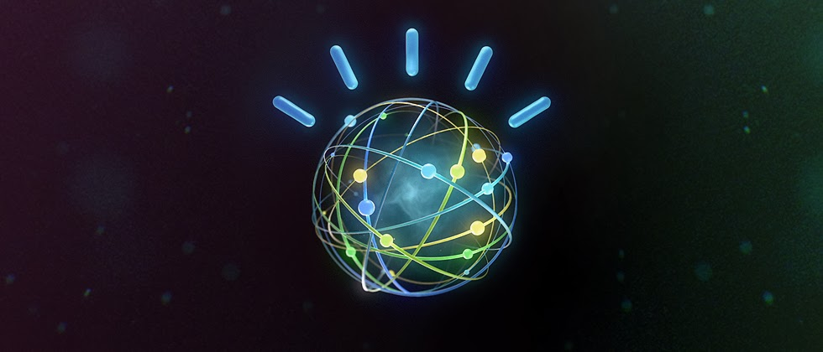
Introduction to ibm Watson and h2o.ai
Presentation By~
Nikita Anand
Hina Gandhi
Shivam Goel

Slide 2
outline
Introduction to H2O
What is H2O and system requirements
H2O Architecture
H2O products
How different REST API communicate with H2O: R, Python, Tableau
H2O Web UI Flow Demo
H2O Demo in R
Introduction to IBM Watson
Tone Analyzer: Basic Flow, Service Use Case
Deploying Example node.js application
Prerequisites
Deploy and run the application in Bluemix
Run the application locally
Demo in R
Language Translator
Applications
Cons

Slide 3
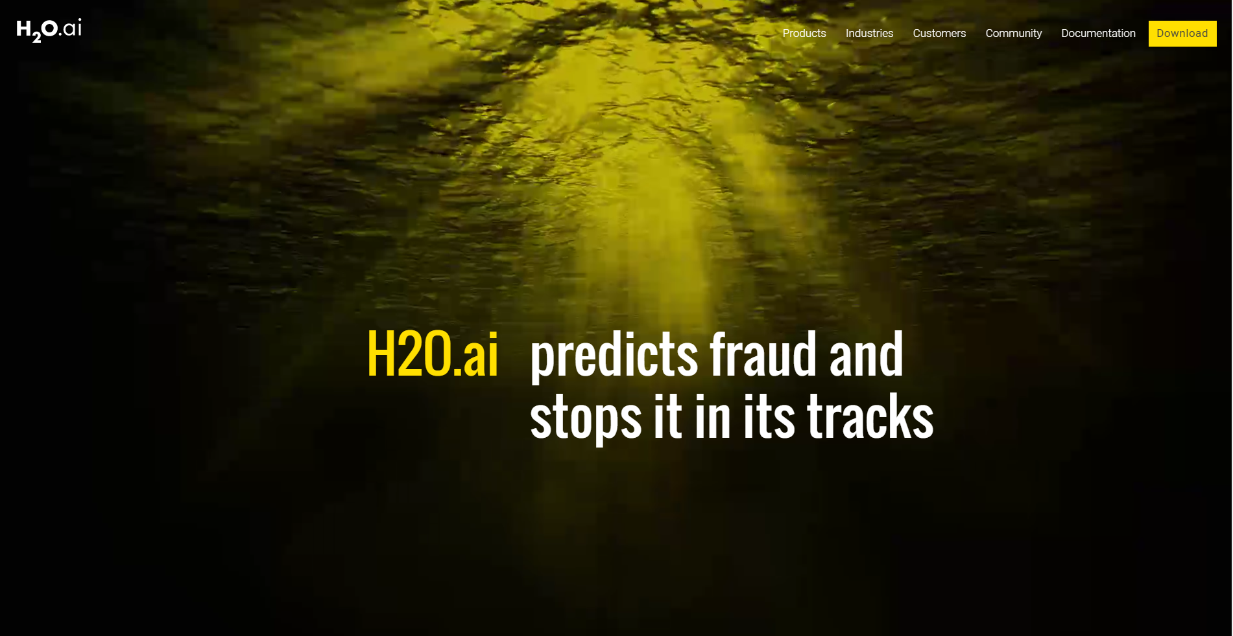
H2o.ai
To Bring Beautiful Business Transformation Through AI and Visual Intelligence

Slide 4

What is h2o
H2O is an open source, in-memory, distributed, fast, and scalable machine learning and predictive analytics platform that allows you to build machine learning models on big data and provides easy productionalization of those models in an enterprise environment.
The speed, quality, ease-of-use, and model-deployment for
the various cutting edge Supervised and Unsupervised
algorithms like Deep Learning, Tree Ensembles, and GLRM
make H2O a highly sought after API for big data science.

Slide 5
System Requirements for H2o
Operating Systems:
Windows 7 or later
OS X 10.9 or later
Ubuntu 12.04
RHEL/CentOS 6 or later
Languages:
Scala, R, and Python are not required to use H2O unless you want to use H2O in those environments, but Java is always required. To build H2O or run H2O tests, the 64-bit JDK is required.
Scala 2.10 or later
R version 3 or later
Python 2.7.x or 3.5.x
Browser: An internet browser is required to use H2O’s web UI, Flow.
Hadoop: Hadoop is not required to run H2O unless you want to deploy H2O on a Hadoop cluster.
Spark: Version 1.4 or later. Spark is only required if you want to run Sparkling Water.

Slide 6
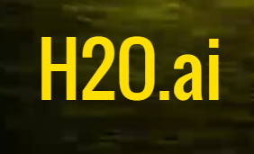



H2o products
STEAM
Notes:
Labels

Slide 7
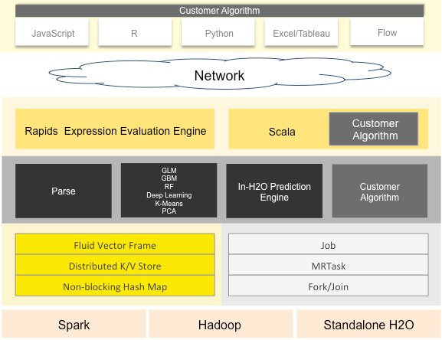
H2o Architecture

Slide 8
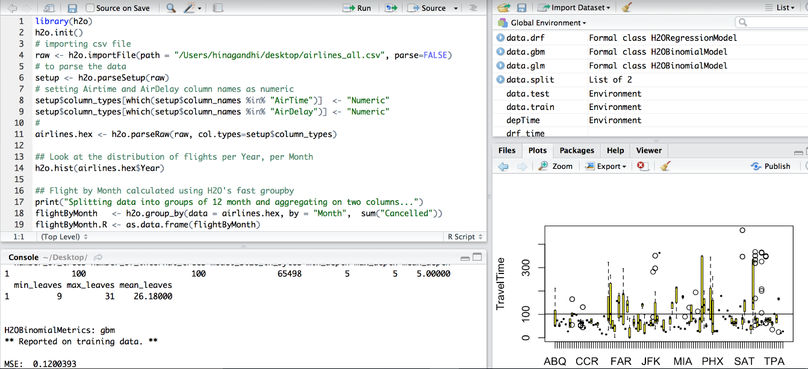
H2o in R
R scripts can use the H2O R package [‘library(h2o)’]

Slide 9
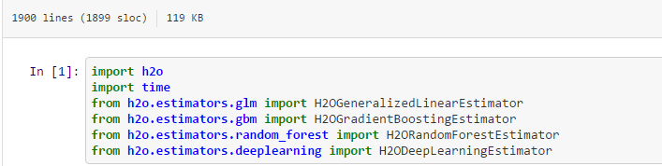
H2o in python

Slide 10
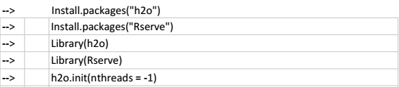
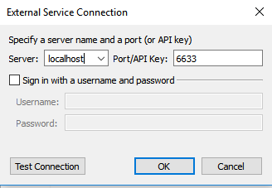
H2o in tableau
Users can pull results from H2O for visualization in Tableau.

Slide 11
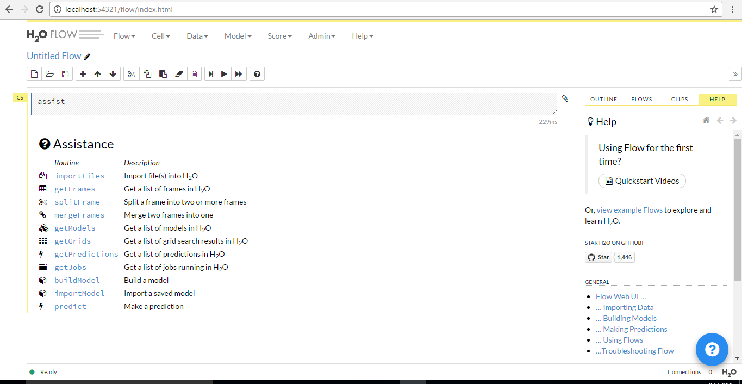
H2o Web ui flow
H2O Flow allows you to use H2O interactively to import files, build models, and iteratively improve them. Based on your models, you can make predictions and add rich text to create vignettes of your work - all within Flow’s browser-based environment.

Slide 12
H2o Web ui flow
Installation Guide for H2O Web Flow
Step 1: Install H2O from this link
Step 2: From your command prompt/terminal, get into the location where your h2o folder is downloaded and look for h2o jar file. Then run the following command
java -jar h2o.jar

Slide 13
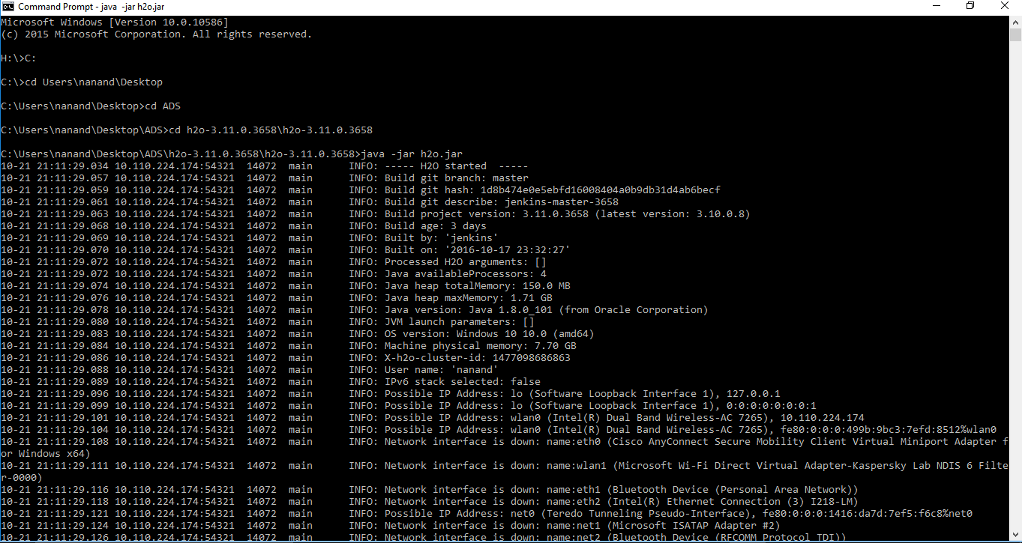
H2o Web ui flow

Slide 14
H2o Web ui flow
Step 3: Open your browser with localhost:54321

Slide 15
H2o Web ui flow
Demo:
Link to dataset: airlines_all.05p.csv
Link to demo PDF: H2O Web Flow.doc

Slide 16
H2o demo in r

Slide 17
Predictive Modeling Landscape: General purpose algorithms (not to scale)
Random Forest
(randomForest)
Gradient Boosted Machines (gbm)
Neural Networks (nnet)
Support Vector Machines (kernlab)
Complexity
Regularized
Linear
Models
(glmnet)
Splines (earth)
Naïve Bayes (klaR)
Generalized Linear Models (glm)
Classification
And Regression Trees (rpart)
Linear Models (lm)
Nearest Neighbor (kNN)
Linear Models
Decision Trees
Others

Slide 18
STEPS:
Importing Dataset on H20
Splitting dataset into train(75) and test(25)
We have used two classification models : GBM and Random Forest
Applying first model: GBM(Gradient Boosting Model). In this model, we have taken distribution as Bernoulli and ntrees = 100
Build GBM Model. GBM model gives the confusion matrix

Slide 19
The below image shows prediction of flights delayed:

Slide 20
Random forest in h2o
Confusion matrix after applying Random Forest:

Slide 21
HISTOGRAM

Slide 22
Scatter PLOT

Slide 23

IBM WATSON

Slide 24
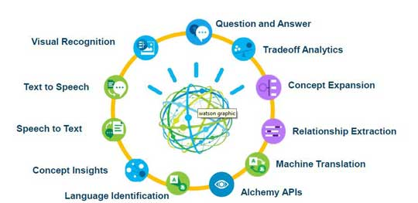
IBM WATSON
IBM's Watson offers few machine learning APIs.
The eight services currently available include:

Slide 25
Tone Analyzer
The IBM Watson™ Tone Analyzer Service uses linguistic analysis to detect three types of tones from written text: emotions, social tendencies, and writing style.
Emotions identified include things like anger, fear, joy, sadness, and disgust
Identified social tendencies include things from the Big Five personality traits used by some psychologists. These include openness, conscientiousness, extraversion, agreeableness, and emotional range.
Identified writing styles include confident, analytical, and tentative.

Slide 26
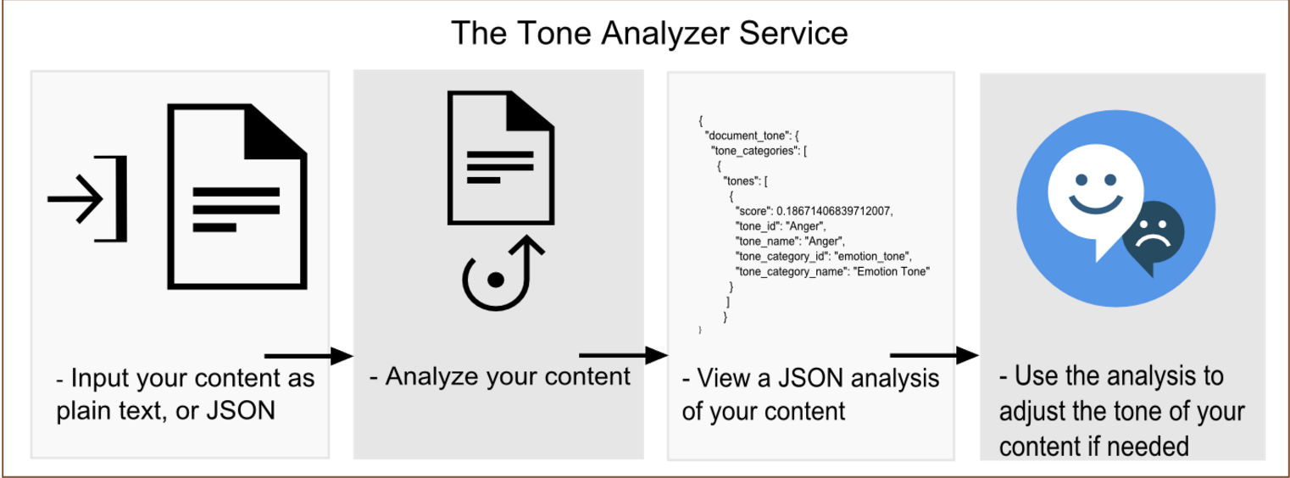
Tone Analyzer Basic Flow

Slide 27
Tone Analyzer Service Use Case
Personal and business communications - Anyone could use the Tone Analyzer service to get feedback about their communications, which could improve the effectiveness of the messages and how they are received.
Market research - Financial advisors and investors could use the Tone Analyzer service to look at the tones reflected in announcements and reports from the companies that they are researching and investing in.
Self-branding - Bloggers and journalists could use to get feedback on their tone.

Slide 28
Deploying Example node.js application
Satisfy the prerequisites to prepare for working with the sample Node.js application.
Prepare the application to obtain the source code for the application and get it ready for deployment in Bluemix.
Deploy and run the application in Bluemix to upload the application to the Bluemix environment and run it from there.
Run the application locally to run the application from your local machine after deploying and running it in Bluemix

Slide 29
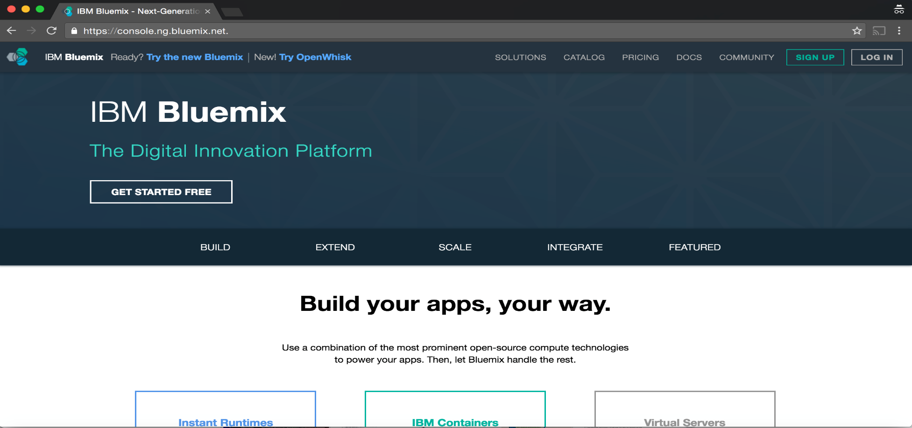
prerequisites
Obtain a Bluemix ID: Register for Bluemix to obtain a Bluemix ID by clicking the SIGN UP button at console.ng.bluemix.net.

Slide 30
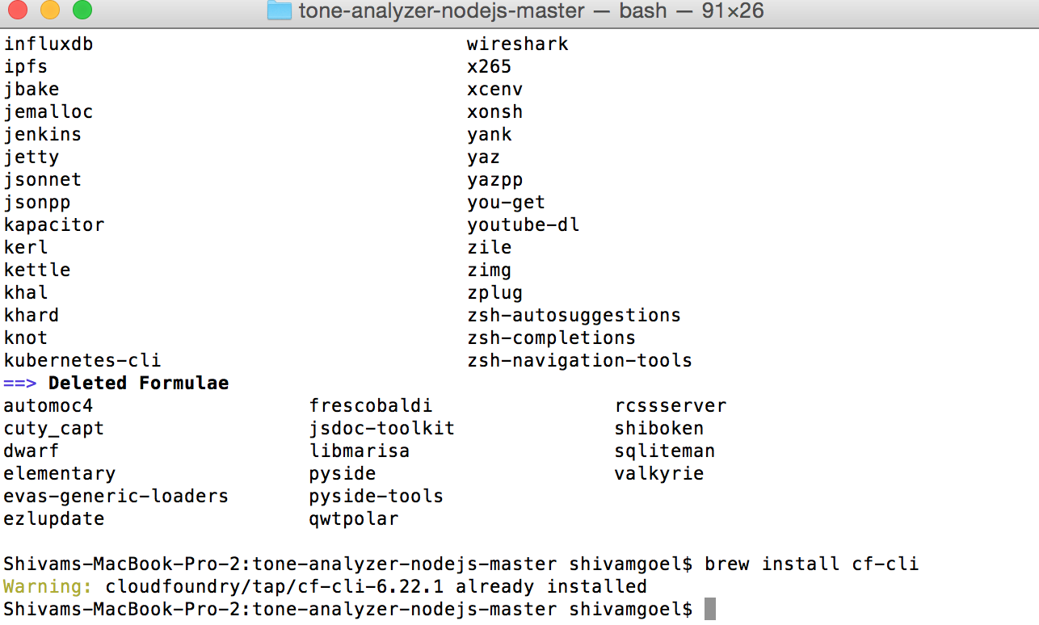
prerequisites
Install the Cloud Foundry command-line tool
https://github.com/cloudfoundry/cli?cm_mc_uid=705009612514146 342 13050&cm_mc_sid_50200000=1465589467#downloads
Commands to install(Mac)
Step 1: Brew tap cloudfoundry/tap
Step 2: Brew install cf-cli

Slide 31
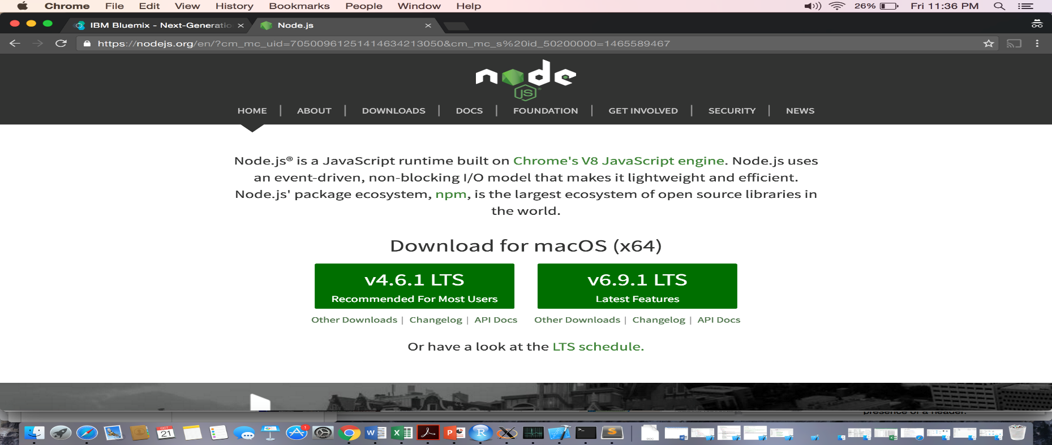
PREREQUISITES
Install the Node.js runtime:
https://nodejs.org/en/?cm_mc_uid=70500961251414634213050&cm_mc_s id_50200000=1465589467

Slide 32
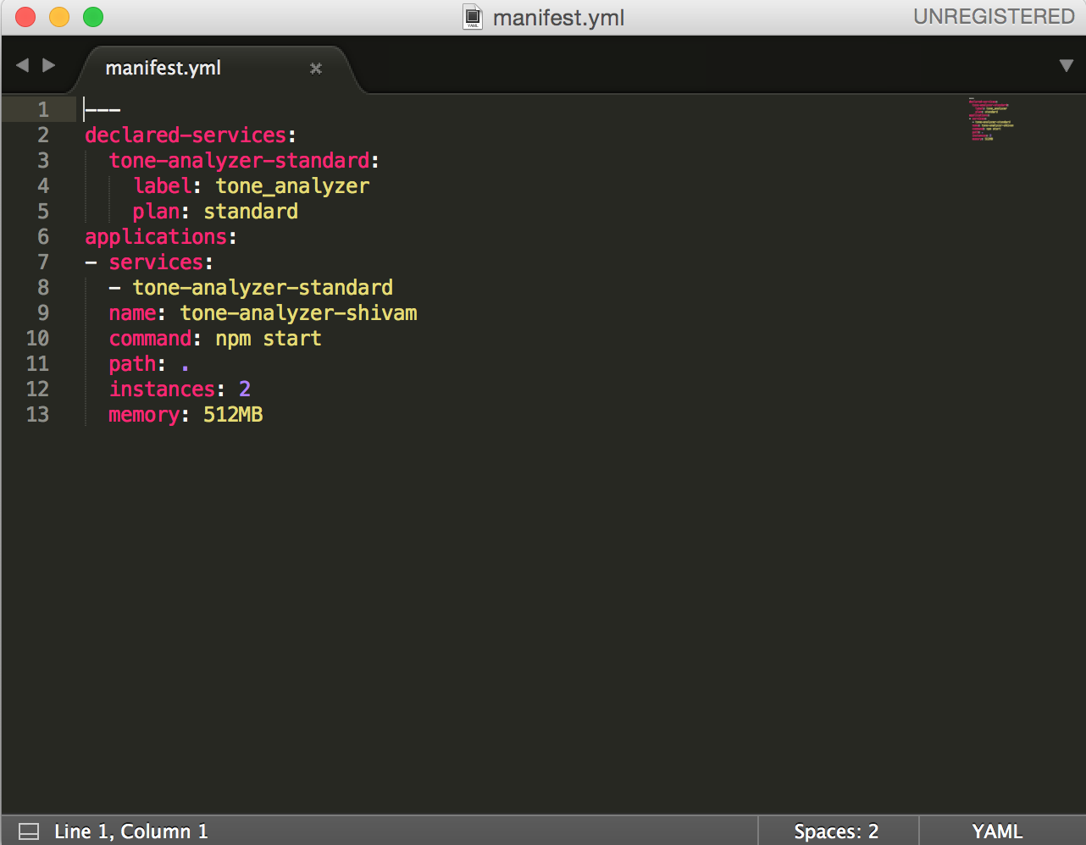
PREREQUISITES
GitHub Repo IBM Watson API
Https://github.com/watson-developer-cloud/tone-analyzer-nodejs
Prepare the application
1. Obtain the source code
2. Modify the manifest file.
3. Note service and plan information

Slide 33
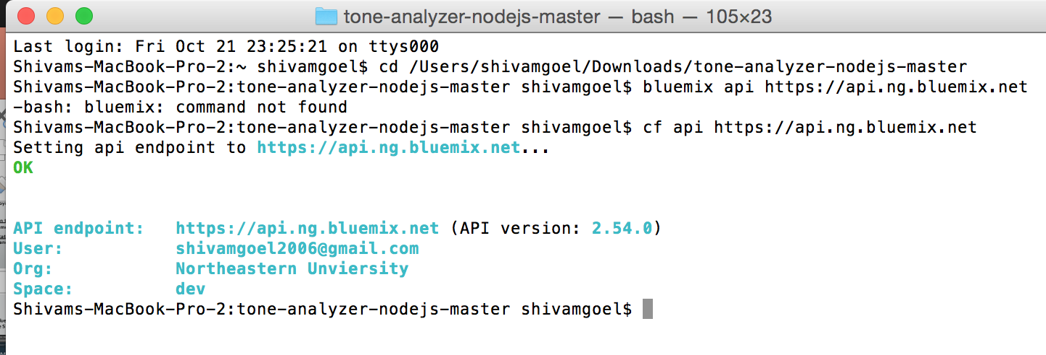
Deploy and run the application in Bluemix
Set the target URL for the API. Use the cf api command to specify the endpoint for contacting the Watson services APIs:
cf api https://api.ng.bluemix.net

Slide 34
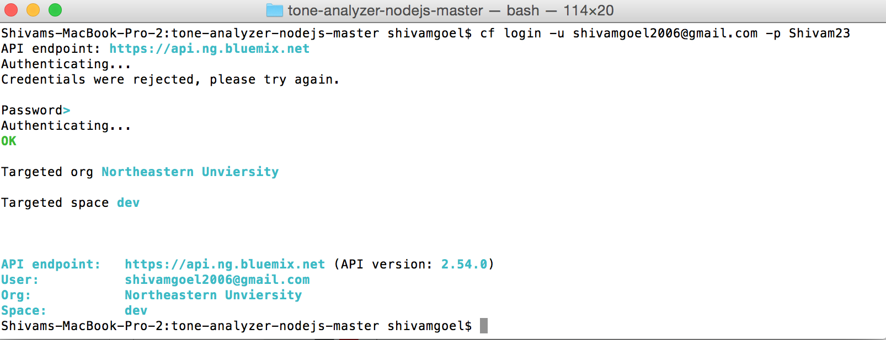
Deploy and run the application in Bluemix
Log in to Bluemix. Use the cf login command to authenticate with your Bluemix ID and password:
cf login -u username -p password

Slide 35
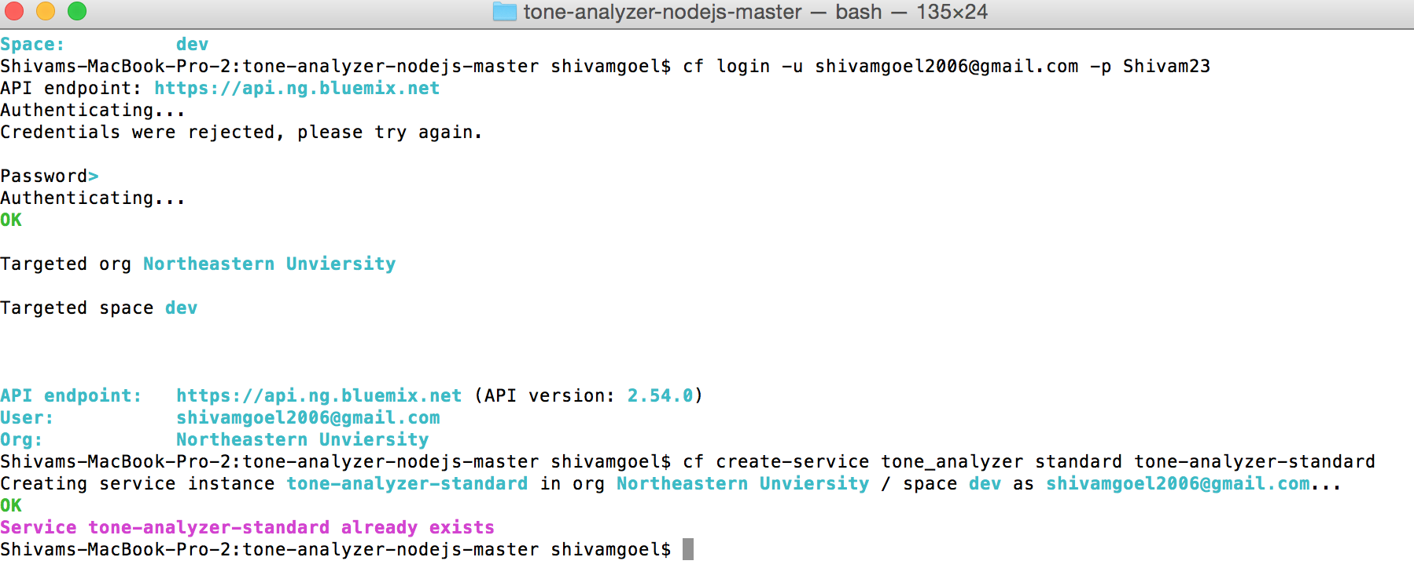
Deploy and run the application in Bluemix
Find the name of the service and plan.
cf create-service service-name service-plan service-instance-name

Slide 36
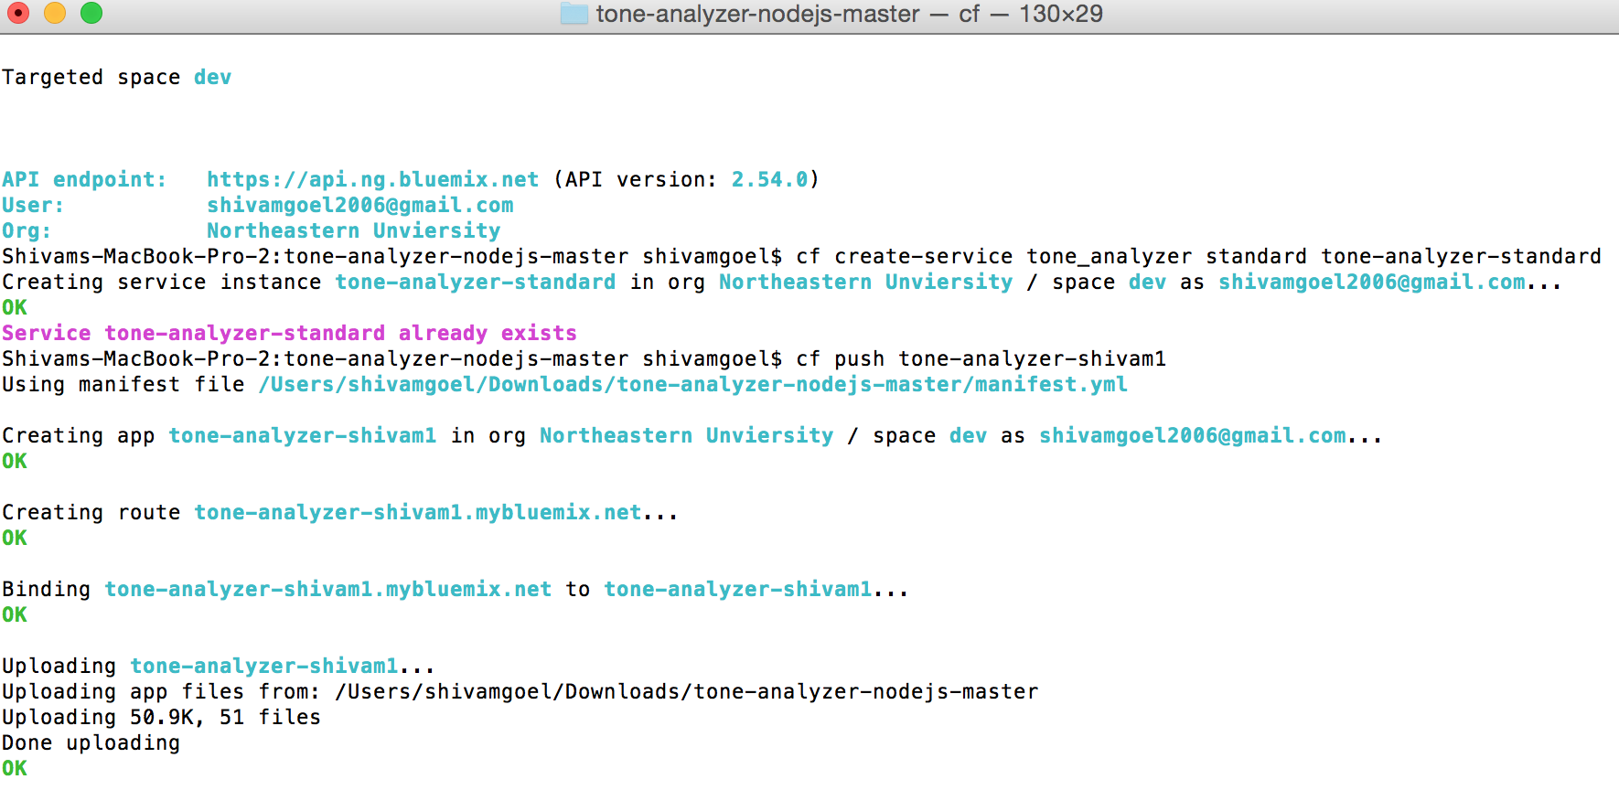
Deploy and run the application in Bluemix
Push the application to Bluemix. The sole argument to the command is the name of your application specified in the manifest.ymlfile.
cf push application-name

Slide 37
Run the application locally
Run your application in Bluemix.
Log in to Bluemix. Use the cf login command to authenticate with your Bluemix ID and password:
cf login -u username -p password
Obtain your Bluemix credentials and URL. Use the cf env command to view the environment variables for your running application:
cf env application-name
Use the URL and your credentials with the application.
Modify app node.js
Install required node packages. npm install
Access the application in a browser (http://localhost:3000)
Access your app by entering the following URL into your browser
tone-analyzer-shivam.mybluemix.net

Slide 38
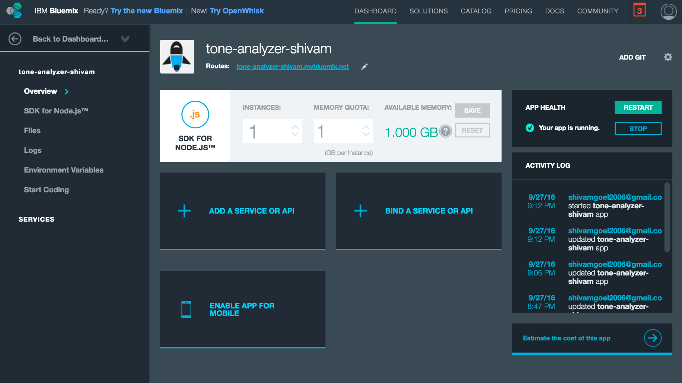
Home Page after Building the Apps

Slide 39
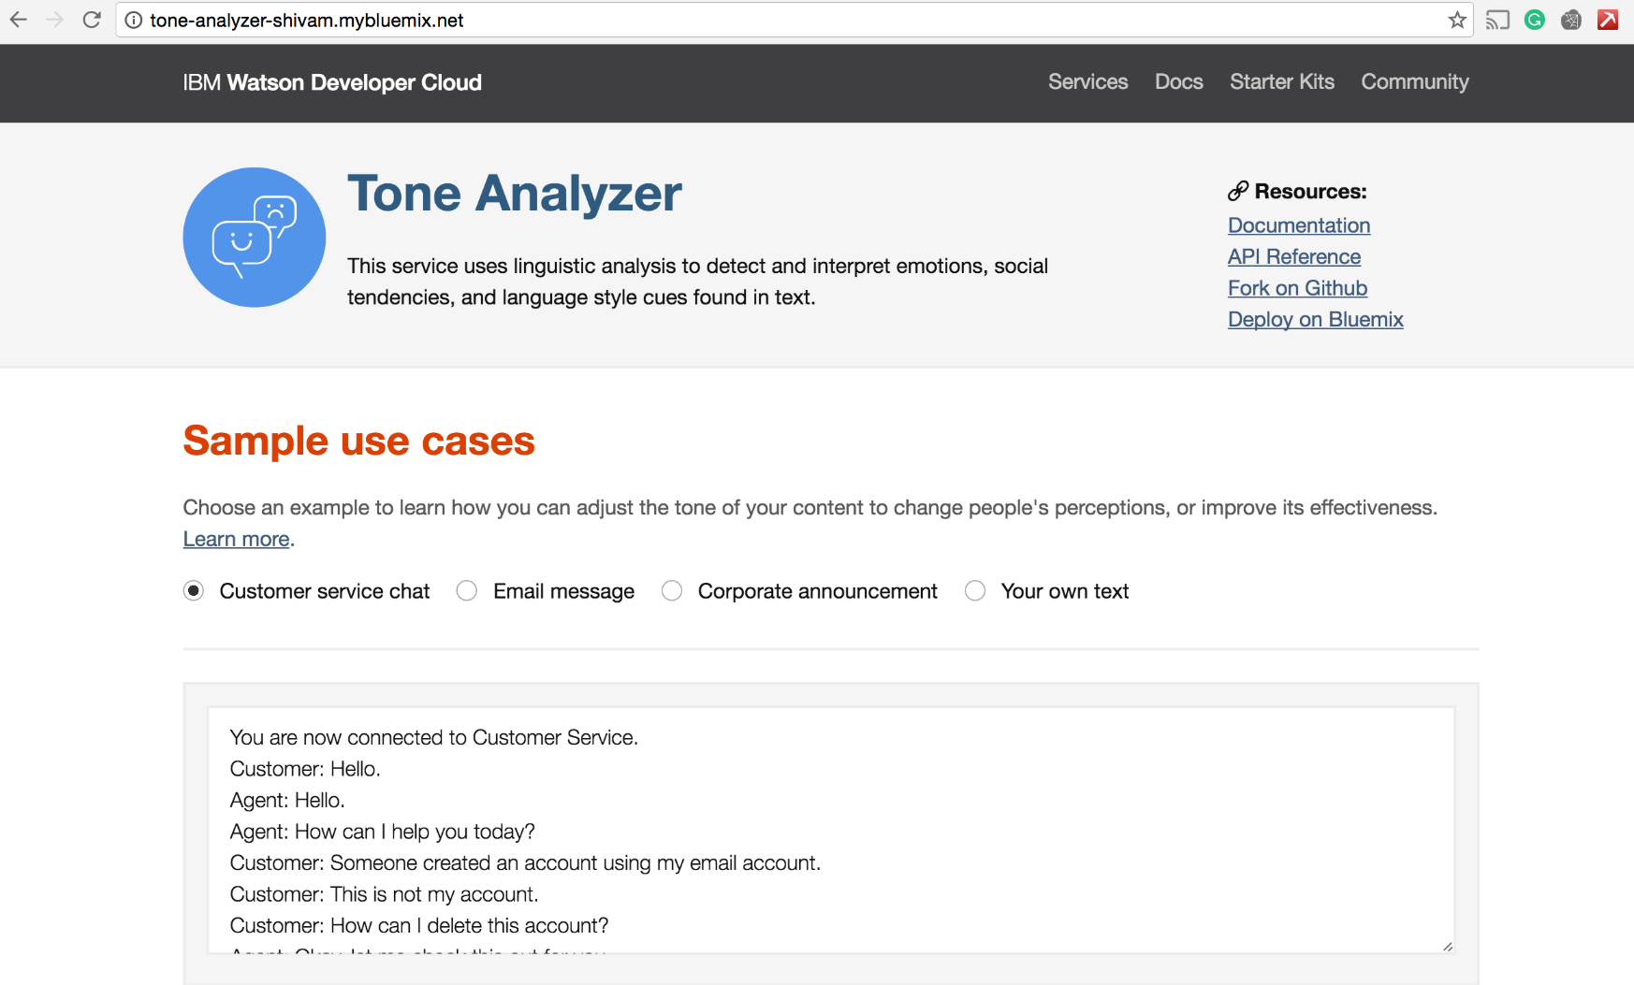
Demo Tone Analyzer

Slide 40
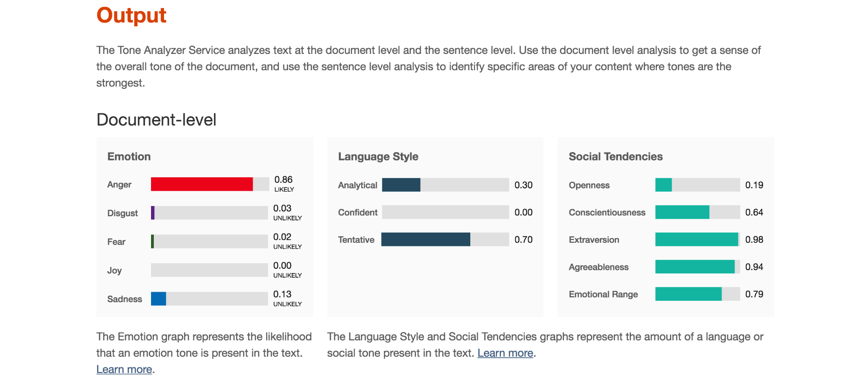
Click on Analyze

Slide 41
Demo in R

Slide 42
TONE ANALYZER
Positive User Input :

Slide 43
Tone shown by ibm watson

Slide 44
Negative user input:

Slide 45
TONE SHOWN BY IBM WATSON

Slide 46
lANGUAGE translator
IBM Watson provides another service ‘Language Translator’ . This service translates one language into another.
The demo application lets you identify a linguistic domain, and then translate text between languages. You enter your text, and select a domain, and wait for the language to be identified.
If the language is not supported, it is identified as unsupported. If that domain supports more than one translation target language, then select the language that you want it translated into, and then the application returns a translation of the input text in both text and JSON.

Slide 48
Demo in R

Slide 49
Language translator
In the below screenshot, we have given some words to IBM Watson and it determines the language with certain confidence level

Slide 50
IBM Watson also provides service to convert into another language
The below screenshot shows some languages and they are converted into Portuguese:

Slide 51
QUESTION:
HOW LANGUAGE TRANSLATOR DIFFERENT THAN GOOGLE TRANSLATOR??
The Language Translator service can be trained over time to provide better accuracy when running translations. To do this, Watson needs to learn from previous translations. Watson Language Translator takes specific terms and phrases into account, such as the names of people or products to ensure that they are translated correctly.
Whereas in Google Translator, if we provide two different languages in one sentence it cannot convert into specific language.
But, if we train Watson, it can predict it gracefully over the time.

Slide 52
HOW TO CUSTOMIZE LANGUAGE TRANSLATOR?
There are multiple ways of customizing Language Translator model. One can train system with pairs of matching terms or phrases in a source and target language. The pairs of terms and phrases are used as either a forced glossary or a parallel corpus depending on whether the translation system considers them as absolute, definitive translations or as alternate translation suggestions. One can also upload a large body of text in a target language (referred to as a monolingual corpus) to improve overall translation quality.

Slide 53
APPLICATIONS
As an example, an English-speaking help desk representative can assist a Spanish-speaking customer through chat (using the conversational translation model).
As another example, a West African news website can curate English news from across the globe and present it in French to its constituents (using the news translation model).
Similarly, a patent attorney in the US can effectively discover prior art (to invalidate a patent claims litigation from a competitor) based on invention disclosures made in Korean with the Korean Patent Office.
Another example would be that a bank can translate all of their product descriptions from English to Arabic using a custom model tailored to that bank's product names and terminology.

Slide 54
CONS
Although IBM Watson Machine detects 25 languages for which it has been trained but could not translate into every language
Watson's Machine Translation system, for instance, only translates between a few pre-selected pairs of languages: English, Brazilian Portuguese, Spanish, French, and Arabic. Even then it doesn't always go both ways. For instance, English to French is supported, but Arabic to French is not.

Slide 55
Question??
Github link: https://github.com/datascience7290/Presentation

